Slide 1
Reproducible Pitch Presentation
CHIJINDU OKPALAOKA

Slide 2
Interactive Map Assignment: Developing Data Products
The goal of this presentation is to demonstrate the Shiny Application developed for the purpose of the project assignment.
Here is the list what shall be in the presentation: OK, you've made your shiny app, now it's time to make your pitch. You get 5 slides (inclusive of the title slide) to pitch a your app. You're going to create a web page using Slidify or Rstudio Presenter with an html5 slide deck.
Here's what you need
5 slides to pitch our idea done in Slidify or Rstudio Presenter
Your presentation pushed to github or Rpubs
A link to your github or Rpubs presentation pasted into the

Slide 3
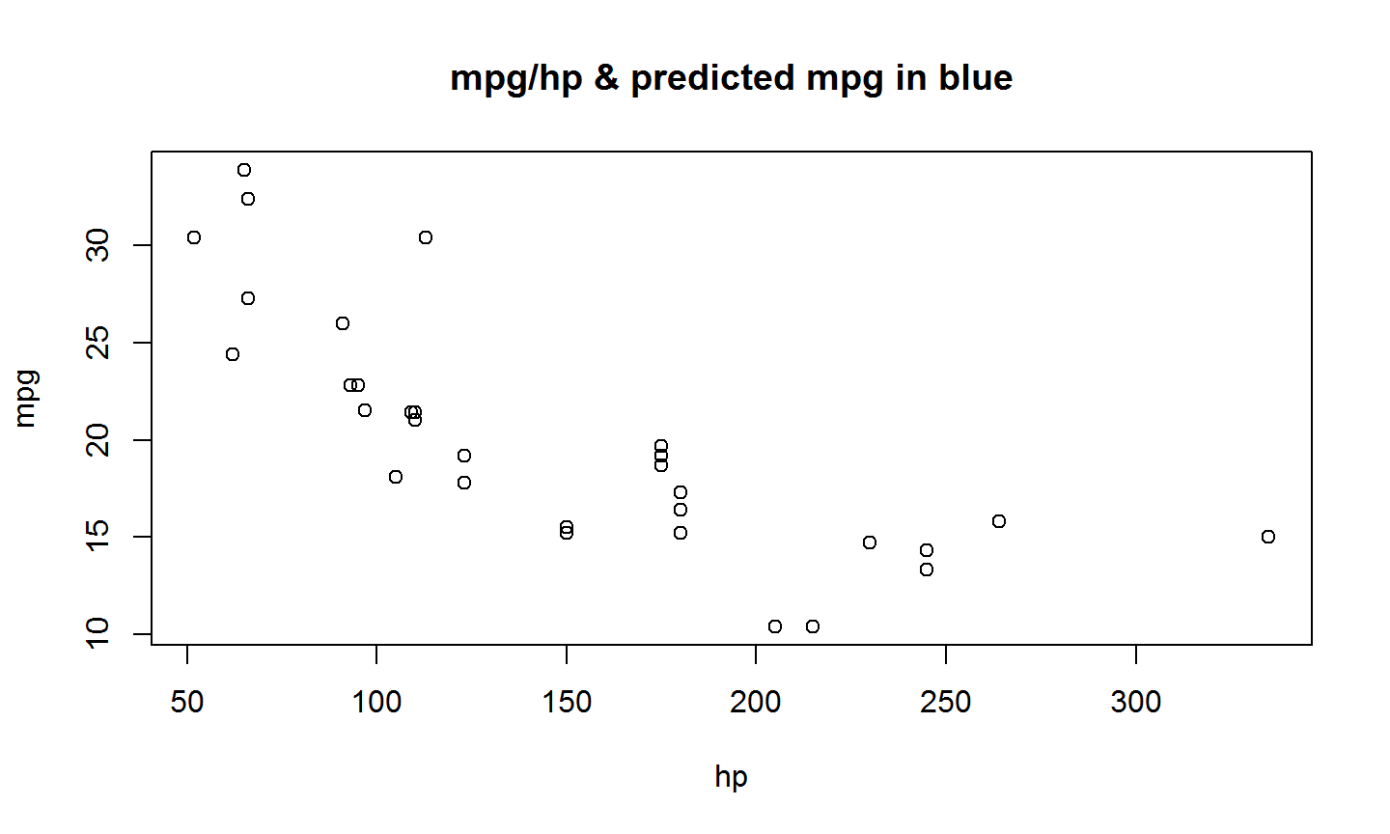
Presentation of an execution of R code to plot the data
data("mtcars")
with(mtcars, plot(hp, mpg, xlab="hp", ylab="mpg", main="mpg/hp & predicted mpg in blue"))

Slide 4
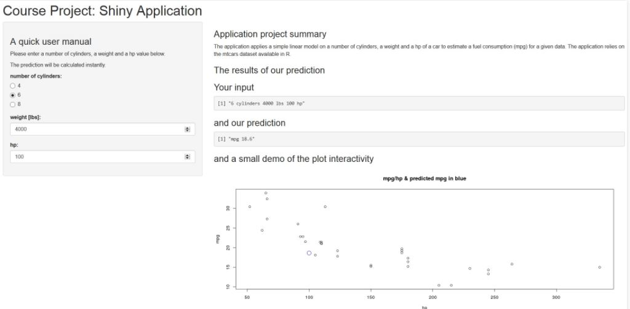
This slide show the application interface embedded as an image.

Slide 5
Summary
The application itself applies the simplest possible linear model to predict a mpg feature for a given no. of cylinders, a vehicle weight and its horsepower.
As we have demonstarted we are capable to build and to publish a RPres presentation with a part of R code to be executed as well as to embed an image from a file.
Thanks for watching!

